Slide 1
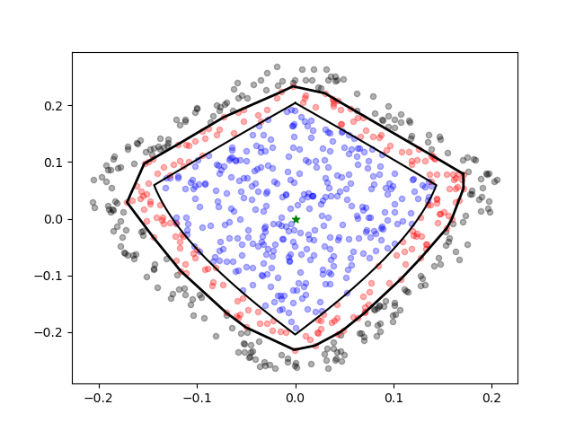

Slide 2
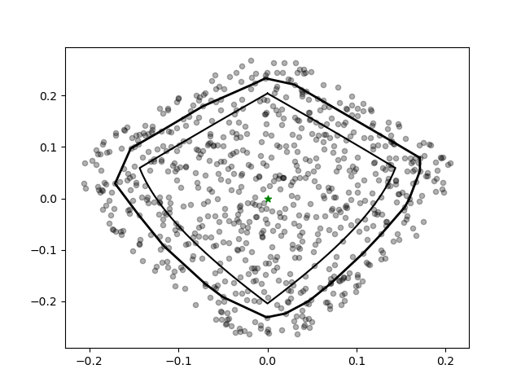

Slide 3
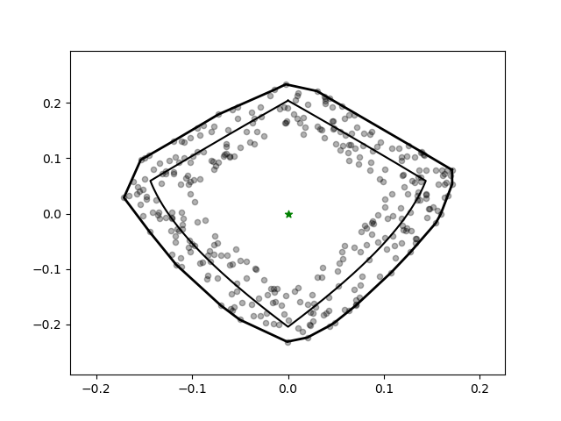

Slide 4
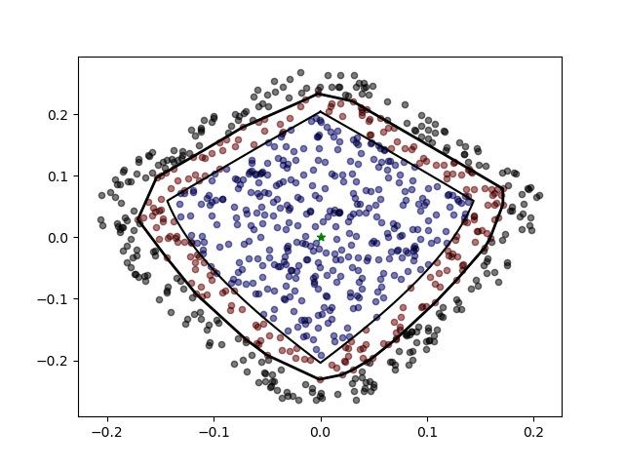
Patch of background map

Slide 5
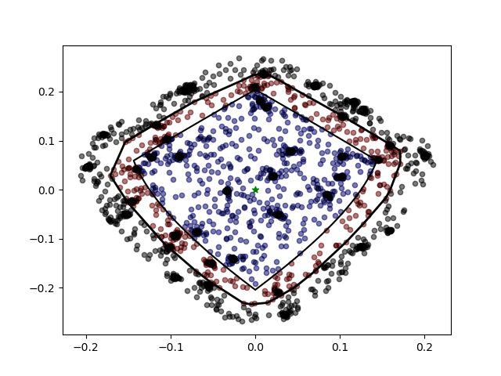
Made using generate_patches.py for the entire map

Slide 6
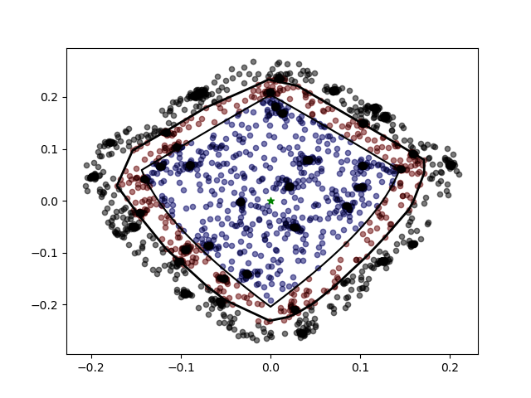
Made using generate_patches.py for background and generate_patches_ps.py for the point source map

Slide 7
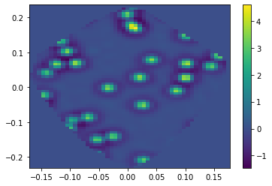
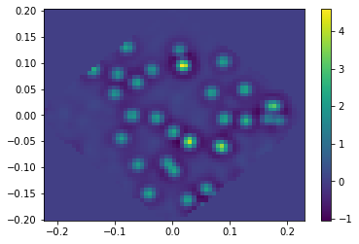

Slide 8
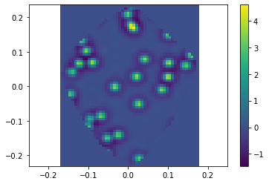
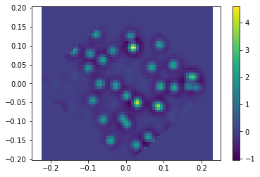

Slide 9
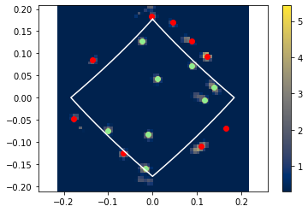
Point sources seem to not be clearly seen by histograms, because the wavelet-based finder is doing a better job at detection than the histograms for bright sources

Slide 10
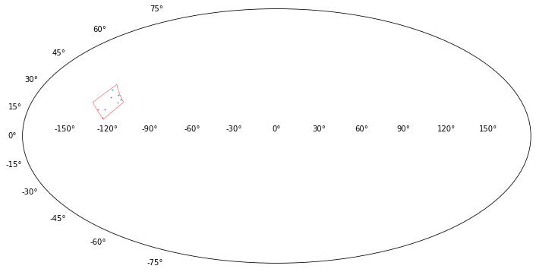

Slide 11
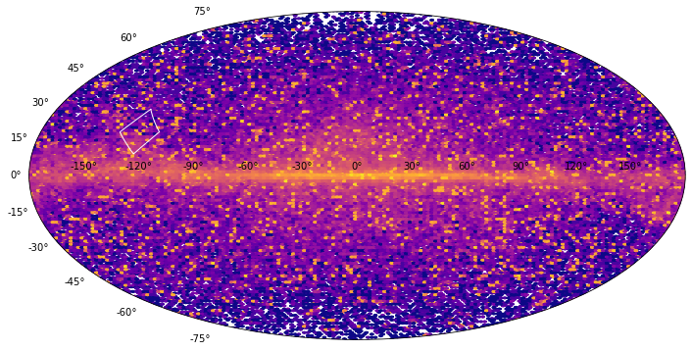

Slide 12
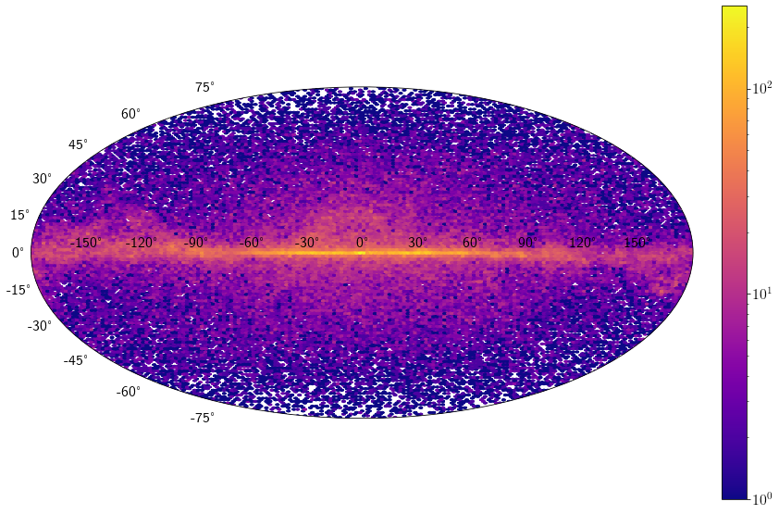
Energy bin = 0
Sampling HEALPix Events directly from theta and phi (1)

Slide 13

Energy bin = 0
Sampling HEALPix Events directly from theta and phi (2)

Slide 14
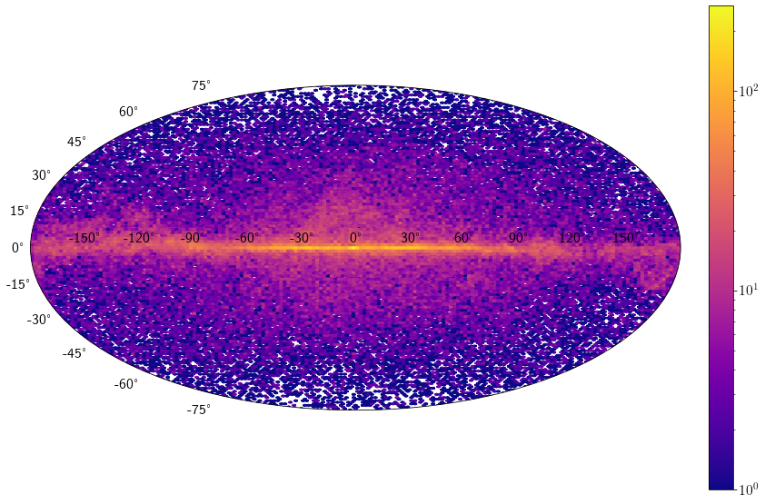
Energy bin = 0
Sampling HEALPix Events using angular_offset function
Conclusion: Sampling techniques are consistent in terms of hexbin creation

Slide 15
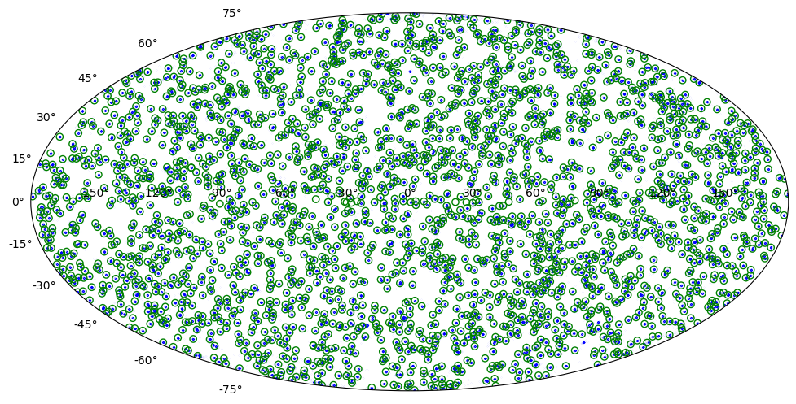
A = 0.6
S0 > 0.3

Slide 17
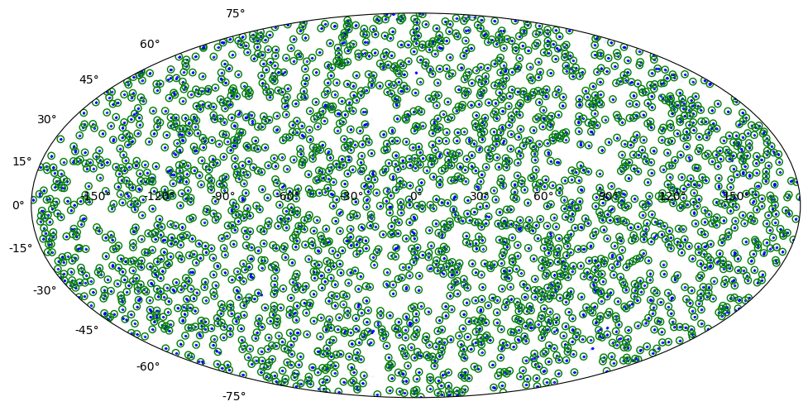
a = 0.6
S0 > 1

Slide 18
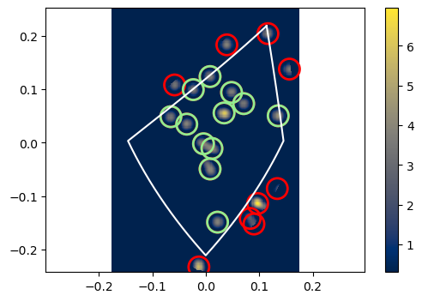
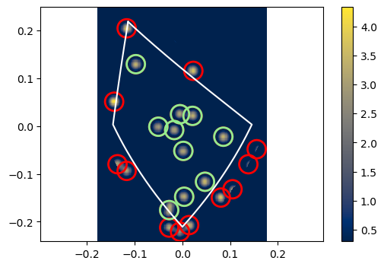
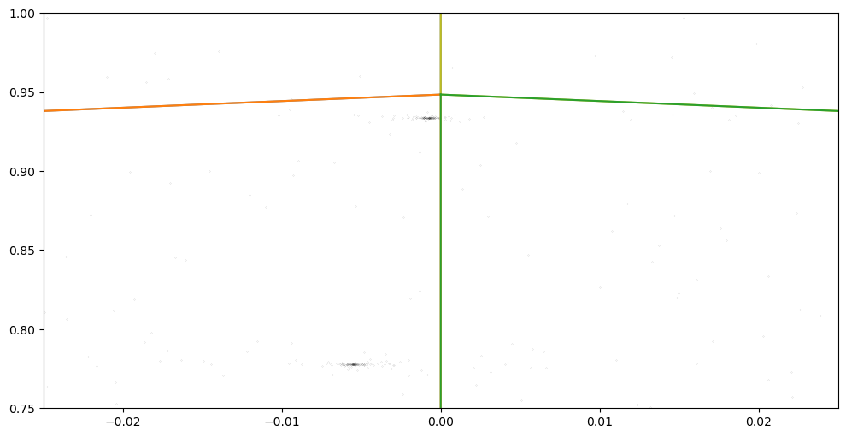
Same point. Though center is inside father pixel, it is not resolved by the grid point! So, the detected grid point is outside in both cases.

Slide 19
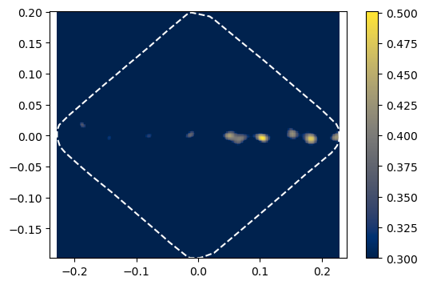
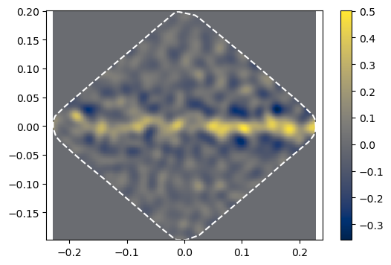
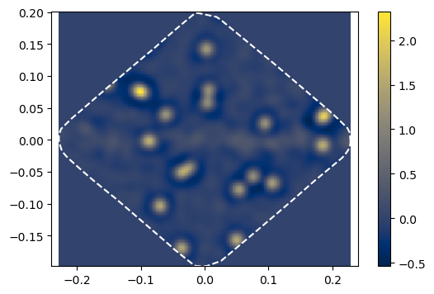
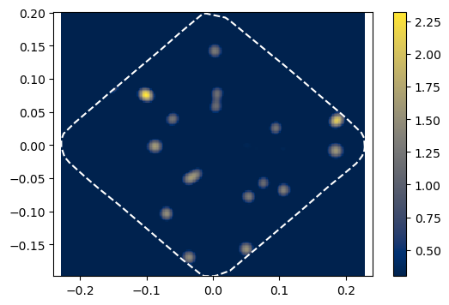
Npix = 94

Slide 20
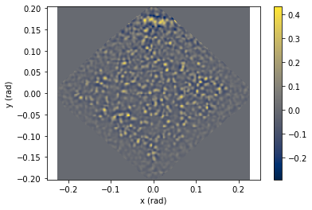

Slide 21
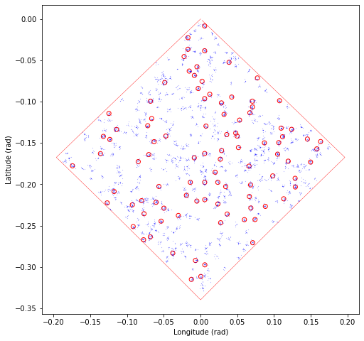

Slide 22
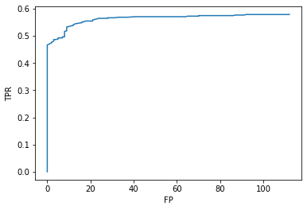

Slide 23
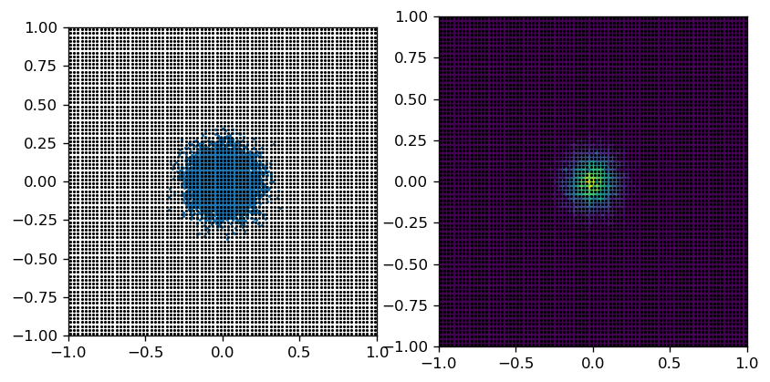
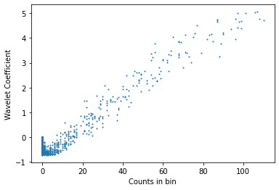
Correlation Between Wavelet Coefficient and Counts per Bin for Gaussian Source
N_data = 10000
Sigma = 0.1
a_scale = 0.1
Grid_scale = 0.025
Note: Clear correlation between point source wavelet coefficients and counts per bin
Note: Pile-up at counts = 0 due to empty bins. High negative values a sign of point sources.

Slide 24
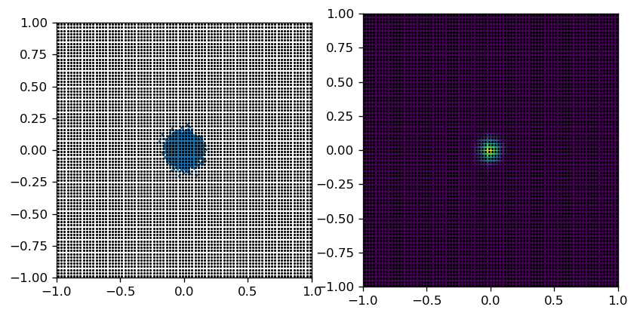
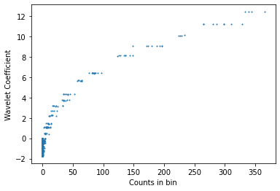
Worsening Performance as Source Size ~ Grid Scale
N_data = 10000
Sigma = 0.05
a_scale = 0.1
Grid_scale = 0.025

Slide 25
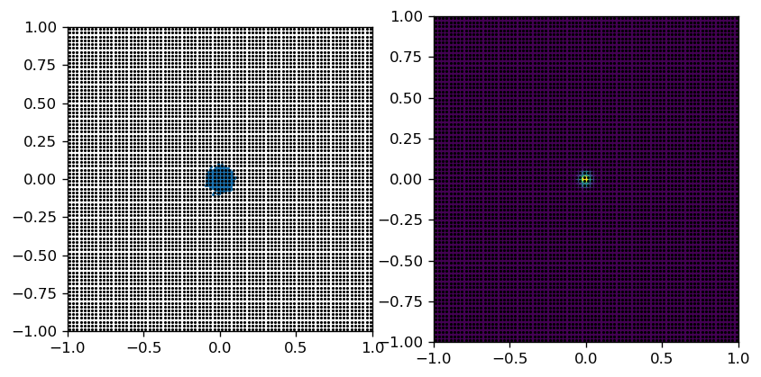
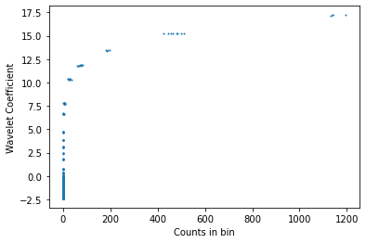
Source Size = Grid Scale
N_data = 10000
Sigma = 0.025
a_scale = 0.1
Grid_scale = 0.025

Slide 26
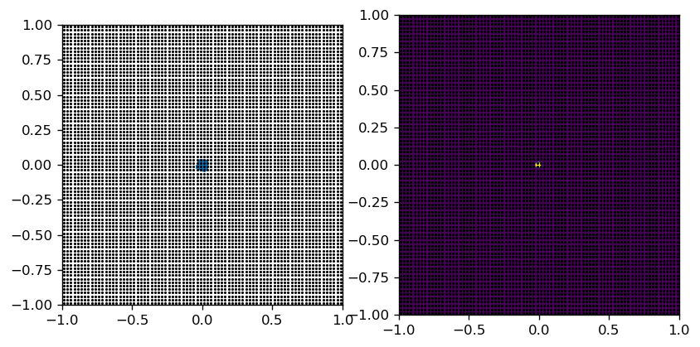
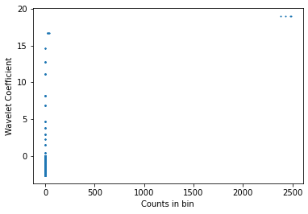
Source Size < Grid Scale
N_data = 10000
Sigma = 0.01
a_scale = 0.1
Grid_scale = 0.025

Slide 27
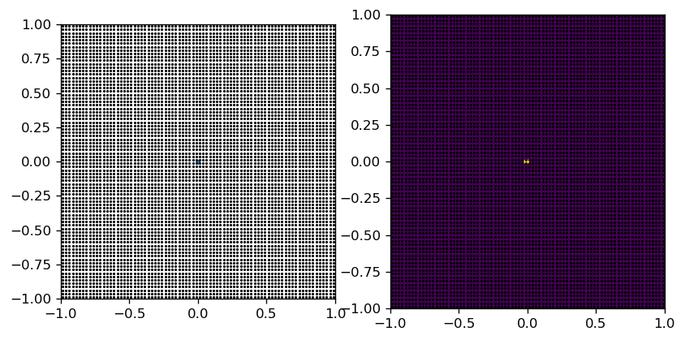
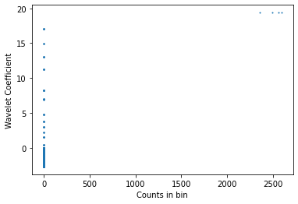
Source Size << Grid Scale
N_data = 10000
Sigma = 0.001
a_scale = 0.1
Grid_scale = 0.025
Note: Though the coefficients have no clear correlation with number of data points, the point sources appear as an isolated point set at high numbers

Slide 28
Instead of decreasing grid size, let’s see what happens if it becomes too large
N_data = 10000
Sigma = 0.1
a_scale = 0.1
Grid_scale = 0.025

Slide 29
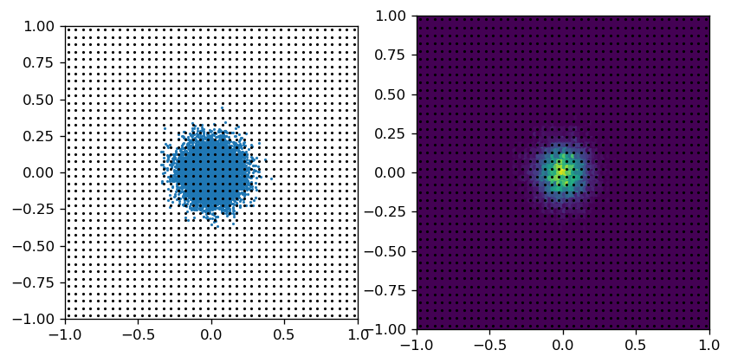
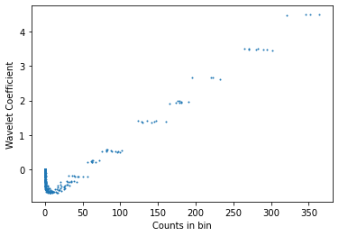
N_data = 10000
Sigma = 0.1
a_scale = 0.1
Grid_scale = 0.05

Slide 30

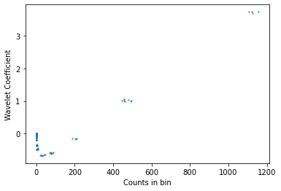
N_data = 10000
Sigma = 0.1
a_scale = 0.1
Grid_scale = 0.1
Note: When the grid scale increases, a correlation still exists. But, the point source signal now clusters into groups. Clusters are likely grouped by radial distance from point source.

Slide 31
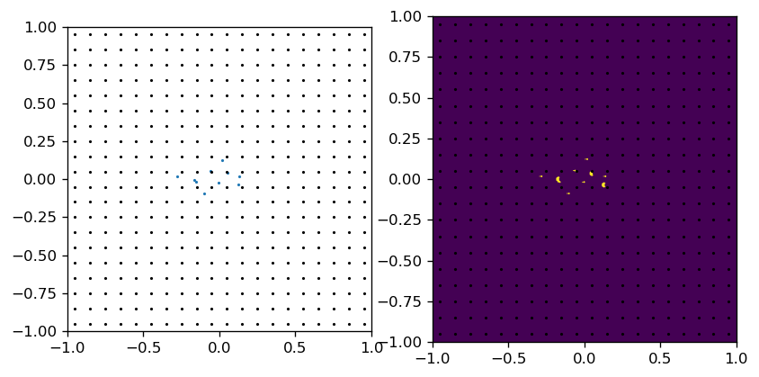
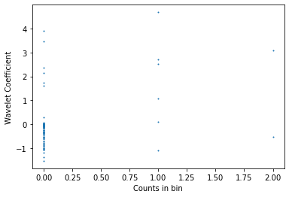
Realistic Situation: Dim Point Sources with Grid Scale = Wavelet Scale
Note: Encounter same issue as before. Pile-up and no clear correlation.
To verify this further, let’s generate a single point source many times and see how the data looks

Slide 32
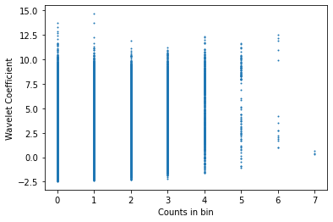
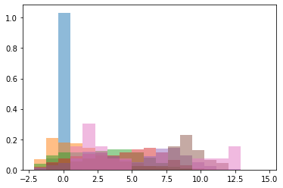
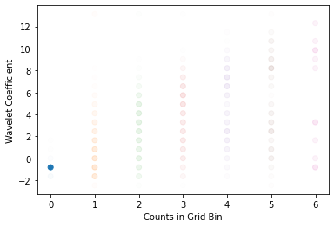
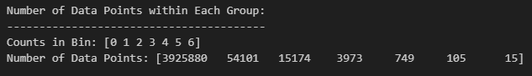
Iterate the same calculation 10000 times to reasonably account for fluctuations
Again, we reach this type of plot that is hard to interpret
N_data = 10
Sigma = 0.1
a_scale = 0.1
Grid_scale = 0.1
Iterate 10000 times
Instead, plot the histograms, color-coded in terms of intensity. The non-zero histograms would be much more faint if we made color prop to normalization

Slide 33
# But, we are interested in the wavelet coefficients in the vicinity of the Gaussian
# So, we should only consider the wavelet coefficients in the vicinity of the Gaussian
# This is better for us. The way that we can define the probability of a source having N
# counts is by this very probability distribution. However, it will depend on the morphology
# and number of datapoints surrounding the point source. In the end, we will have to
# perform tests to assign a probability of how often we obtain the right distribution given
# this probabilistic model.
# If we fail too many times doing things like this, it may be best to employ an ML
# algorithm for classifying the number of datapoints making up a point source.
# We want to make the wavelet coefficient as independent as possible of
# these hyperparameters like the overall normalization of the dataset.
# Another option is to use one wavelet map for the point source's position itself
# Then, use new wavelet maps on the positions of the point sources to produce
# an estimate of the number of datapoints that it makes up. By doing this for point sources
# injected in the background, we are not assuming empty background or uniform background.

Slide 34
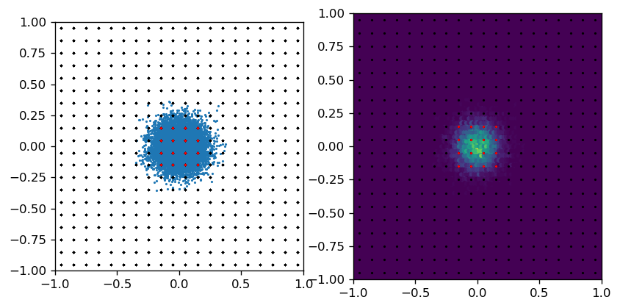
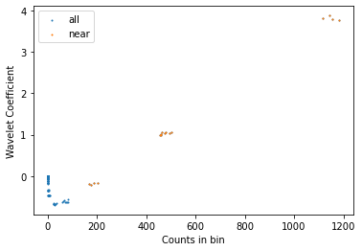
Check point sources only for grid points near a Gaussian
$$d<\sqrt{{\left(2σ\right)}^{2}+{\left(ε_{grid}\right)}^{2}}$$
As expected, the point source makes up the clusters
N_data = 10000
Sigma = 0.1
a_scale = 0.1
Grid_scale = 0.1

Slide 35
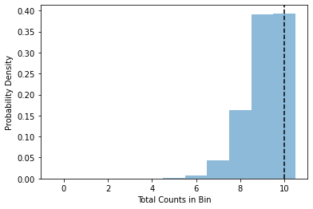

Iterate the same calculation 10000 times to reasonably account for fluctuations
All points
Pdf for the number of photons identified in grid point bins
True number
$$d<\sqrt{{\left(2σ\right)}^{2}+{\left(ε_{grid}\right)}^{2}}$$

Slide 36
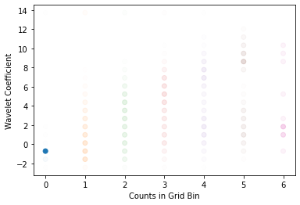


Allow for more grid points to surround point source!
Obviously performs great when ALL THE DATA POINTS ARE FROM POINT SOURCE.
With non-zero background, this will come at the risk of contamination
$$d<\sqrt{{\left(3σ\right)}^{2}+{\left(ε_{grid}\right)}^{2}}$$

Slide 37
Try the same things. Mainly shooting for estimating the total number of points corresponding to the point source.
Simple Addition: Uniform Background!
At this point, we start using the unnormalized wavelet coefficients. This allows us to directly interpret the wavelet coefficients as a function of the number of counts. For example, if half of the data is background and half the data signal, then in some sense the interpretation of the wavelet coefficients depend on the overall normalization of the data.

Slide 38




Uniform background with no point source
Background fluctuations (isolated photons can look like point sources)
Wavelet coefficient distributions are very similar for each counts
N_uni = 100
Grid_scale = 0.1
Iterate 1000 times

Slide 39







Uniform Only
Uni + PS
Uni + PS (only PS grid points)
N_gauss = 10
N_uni = 100
Sigma = 0.1
a_scale = 0.1
Grid_scale = 0.1
Iterate 1000 times

Slide 40


Simple Estimation of PS Photon Counts
Red: Signal Region
Orange: Background Region
To estimate number of photons making up PS,
Count number of photons in signal region
Estimate density of photons in background region
Estimate number of background photons by assuming signal region has uniform component with same density as background region
Subtract total number of photons by background photons
Advantages: Simple
Disadvantages: Only claim total number of photons.
Does not identify exactly which photons are signal and background.
Alternatives: Subtract wavelet maps and infer number of photon counts at each grid bin using the resulting map.

Slide 41

A More Extreme Case
N_gauss = 10
N_uni = 1000
Sigma = 0.1
a_scale = 0.1
Grid_scale = 0.1
Iterate 1000 times

Slide 42




Playing it safe and extending the point source region seems to give better performance either
$$d<\sqrt{{\left(3σ\right)}^{2}+{\left(ε_{grid}\right)}^{2}}$$
$$…{< d}_{bkgd}<\sqrt{{\left(6σ\right)}^{2}+{\left(ε_{grid}\right)}^{2}}$$
Low PS, Low Bkgd
High Bkgd, Low PS
High PS, Low Bkgd
Low PS, No Bkgd

Slide 43



Slide 44



Slide 45



Slide 46



Slide 47



